Slide 1

CSA0613-Design and Analysis of Algorithms
Asymptotic Analysis of Sorting Algorithms Analyze the efficiency of Merge Sort and Quick Sort using asymptotic notations.
CO1-ASSESSMENT TOOL 03-TECHNICAL PRESENTATION
PRESENTED BY
D.G.RAGHAVI (192521173)
GUIDED BY
Dr Mary Harin Fernandez F

Slide 2


INTRODUCTION
Sorting is the process of arranging data in ascending or descending order. Merge Sort and Quick Sort are two widely used sorting algorithms. Both algorithms use the divide-and-conquer approach to sort data efficiently. Asymptotic analysis evaluates algorithm performance as the input size increases. Big-O, Big-Theta, and Big-Omega notations describe worst, average, and best-case complexities.

Slide 3
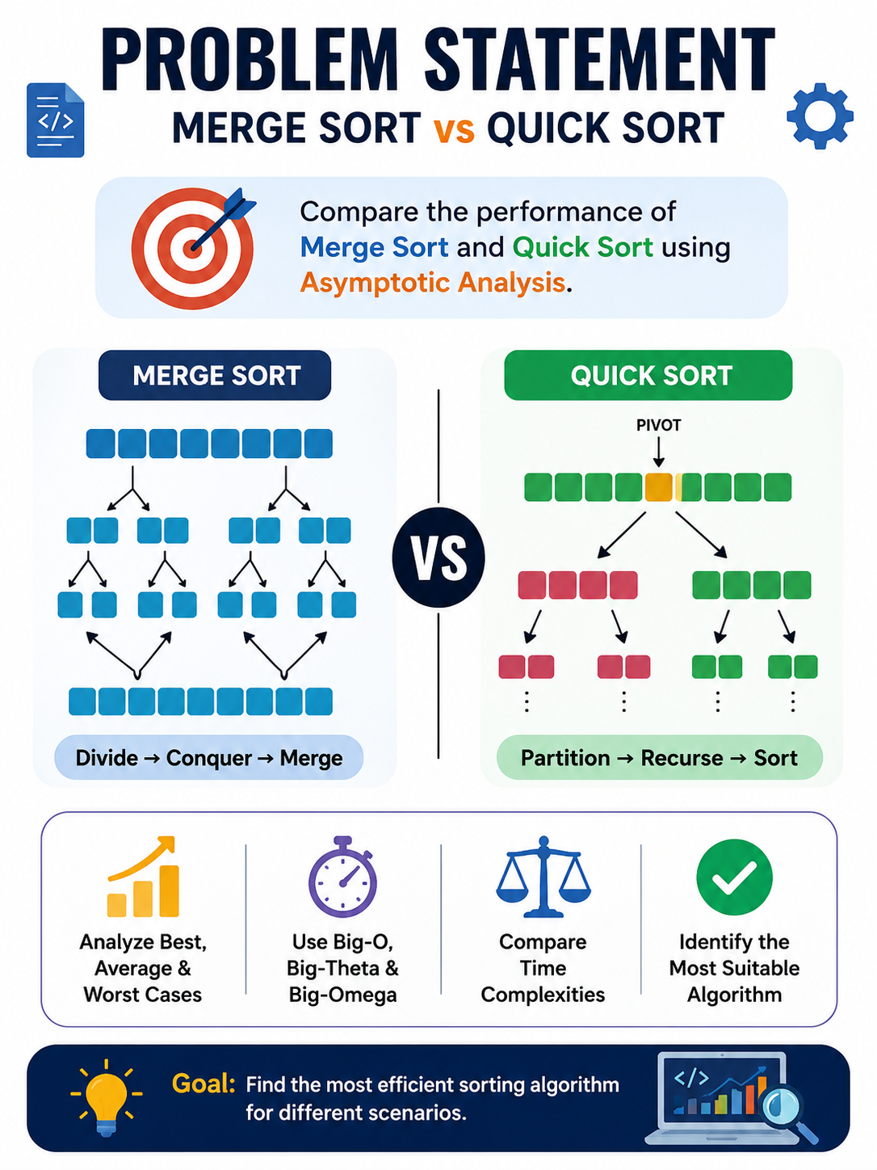
Title & Introduction
PROBLEM STATEMENT
Large datasets require efficient sorting for faster processing.
Compare the performance of Merge Sort and Quick Sort.
Analyze their best, average, and worst-case time complexities.
Use Big-O, Big-Theta, and Big-Omega notations for comparison.
Identify the most suitable algorithm for different scenarios.

Slide 4
ALGORITHMS & PSEUDOCODE
Merge Sort Algorithm
Start.
If the array contains 0 or 1 element, return.
Divide the array into two equal halves.
Recursively apply Merge Sort to both halves.
Merge the two sorted halves into a single sorted array.
Stop.
MergeSort(A)
if size ≤ 1
return
Split array into two halves
MergeSort(left)
MergeSort(right)
Merge(left,right)
Quick Sort Algorithm
Start.
If the array contains 0 or 1 element, return.
Choose a pivot element.
Partition the array into elements smaller and greater than the pivot.
Recursively apply Quick Sort to the left and right partitions.
Stop
QuickSort(A,low,high)
Choose Pivot
Partition array
QuickSort(left)
QuickSort(right)

Slide 5
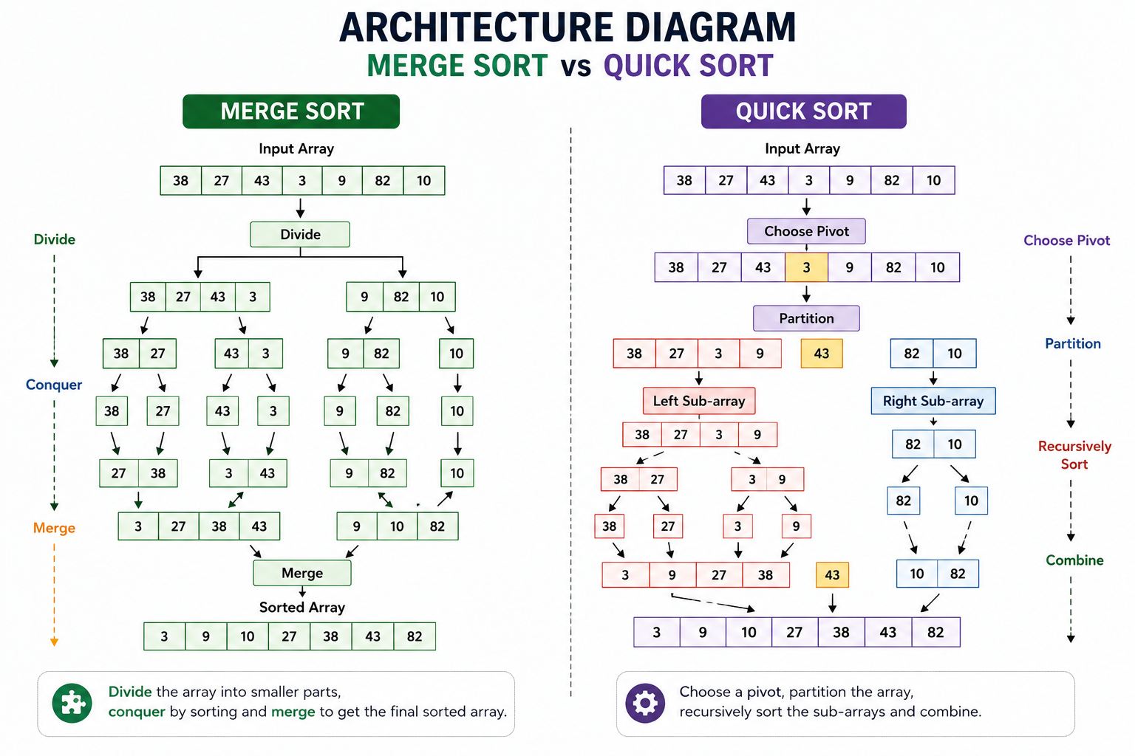
ARCHITECTURE DIAGRAM

Slide 6
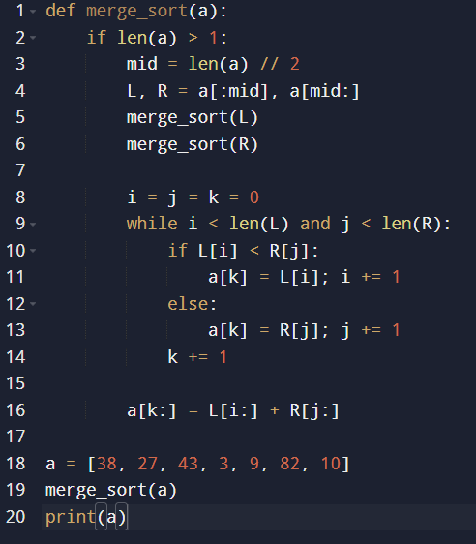
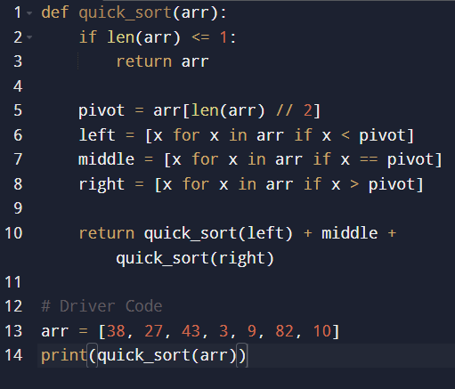

IMPLEMENTATION
Quick Sort.
Merge Sort

Slide 7
CONCLUSIONS
Merge Sort and Quick Sort are efficient divide-and-conquer sorting algorithms.
Merge Sort provides a consistent O(n log n) time complexity in all cases.
Quick Sort is generally faster in the average case but can have a worst-case complexity of O(n²).
Asymptotic notations (Big-O, Big-Theta, and Big-Omega) help compare algorithm performance.
The choice of algorithm depends on the dataset size, input characteristics, and application requirements.

Slide 8
REFERENCES
Cormen, T. H., Leiserson, C. E., Rivest, R. L., & Stein, C. (2022). Introduction to Algorithms (4th ed.). MIT Press.
Sedgewick, R., & Wayne, K. (2011). Algorithms (4th ed.). Addison-Wesley
. Horowitz, E., Sahni, S., & Rajasekaran, S. (2008). Fundamentals of Computer Algorithms (2nd ed.). Universities Press.
Knuth, D. E. (1998). The Art of Computer Programming, Volume 3: Sorting and Searching (2nd ed.). Addison-Wesley.

Slide 9
THANK YOU

